Slide 1

Introduction to Data Analytics
ITE 5201
Lecture2-Data Preparation Using Numpy

Slide 2

Sources of Data and Privacy
Open Data:
The Open Knowledge Foundation describes Open Data as “any content, information or data that people are free to use, reuse, and redistribute without any legal, technological, or social restriction.”
Private Data
Data related to an expectation of privacy and regulated by a
particular country or an organization
Copyright © 2018 Pearson Education, Inc. All Rights Reserved.

Slide 3
Types of Data
Structured Data
Data entered and maintained in fixed fields within a file or record
Easily entered, classified and analyzed in Relational Databases or Spreadsheets
Unstructured Data
Lack of organization- Raw Data
Photo contents, Audio, Video, Web pages, Blogs, Books, Journals, Presentations, Articles, Email and text in general
Copyright © 2018 Pearson Education, Inc. All Rights Reserved.

Slide 4
Structured vs Unstructured Data
Structured data is clearly defined and searchable types of data, while unstructured data is usually stored in its native format.
Structured data is easy to search and analyze, while unstructured data requires more work to process and understand.
Structured data exists in predefined formats, while unstructured
data is in a variety of formats.
Copyright © 2018 Pearson Education, Inc. All Rights Reserved.

Slide 5
Types of Data …
Data at Rest:
Data stored in a physical location such as a server hard drive or within a data center.
Data In Motion:
Dynamic data that requires real-time processing before the data becomes irrelevant or obsolete.
Data in transit, or data in motion, is data actively moving from one location
to another such as across the internet or through a private network.
Copyright © 2018 Pearson Education, Inc. All Rights Reserved.

Slide 6
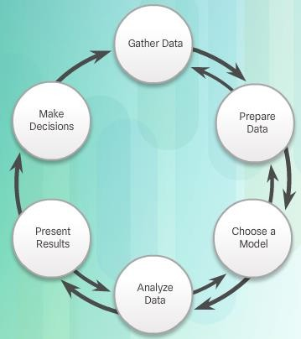
Data Analysis Life Cycle
Copyright © 2018 Pearson Education, Inc. All Rights Reserved.

Slide 7
THE 6 STEP MODEL
Gathering the data - The process of locating data and then determining when to stop collecting.
Data Types can be json, xml, Ms-word, csv, pdfs etc
Preparing the data - Multiple tasks to transform the data into an appropriate format appropriate for the selected tool.
Extract / Transform / Load: Prepare for analysis after converting to an appropriate format.
Copyright © 2018 Pearson Education, Inc. All Rights Reserved.

Slide 8
THE 6 STEP MODEL
Choosing a model - This step includes choosing an analysis technique that will best answer the question with the data available. (Time-series, Linear / Exponential Trend)
Analyzing the data (Evaluation) - The process of testing the model against the data and determining if the model and the analyzed data are reliable. Were you able to answer the question with the selected tool?
Presenting the results (Deployment) - The process of communicating the results to decision-makers.
Making decisions (Business Understanding)- Leaders may incorporate the new knowledge as part of the overall strategy. Cycle repeats again
Copyright © 2018 Pearson Education, Inc. All Rights Reserved.

Slide 9
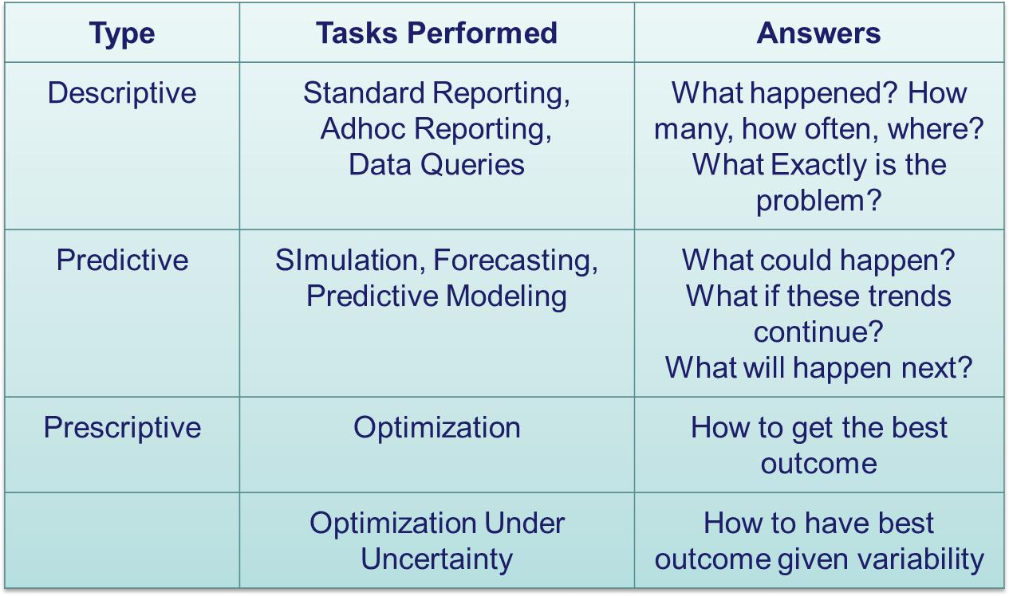
TYPES OF ANALYTICS
Copyright © 2018 Pearson Education, Inc. All Rights Reserved.

Slide 10
Introducing the pandas library
Why pandas:
Fast data cleaning-preparation and analysis
Easy to use for data visualization and machine learning
Copyright © 2018 Pearson Education, Inc. All Rights Reserved.

Slide 11
Pandas
The Pandas module is used for working with tabular data.
It allows us to work with data in table form, such as in CSV or SQL database formats.
We can also create tables of our own, and edit or add columns or rows to tables.
Pandas provides us with some powerful objects like DataFrames and Series which are very useful for working with and analyzing data.
Copyright © 2018 Pearson Education, Inc. All Rights Reserved.

Slide 12
Numpy
The Numpy module is mainly used for working with numerical data.
It provides us with a powerful object known as an Array.
With Arrays, we can perform mathematical operations on multiple values
in the Arrays at the same time.
Also perform operations between different Arrays, similar to matrix
operations.
Copyright © 2018 Pearson Education, Inc. All Rights Reserved.

Slide 13
Indexing in pandas
Indexing in pandas means simply selecting particular rows and columns of data from a DataFrame.
Indexing could mean selecting all the rows and some of the columns, some of
the rows and all of the columns, or some of each of the rows and columns.
This course uses;
A set of square-brackets[…]
The .loc[] indexer
Copyright © 2018 Pearson Education, Inc. All Rights Reserved.

Slide 14
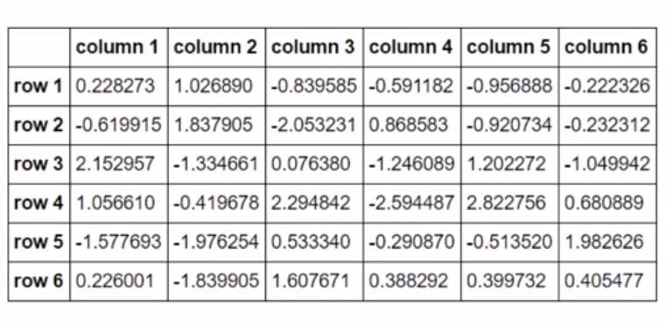
Introducing the pandas library
Data Frame object:
Acts like a spreadsheet in Excel
Made of a set of series objects
Indexable
Copyright © 2018 Pearson Education, Inc. All Rights Reserved.

Slide 15
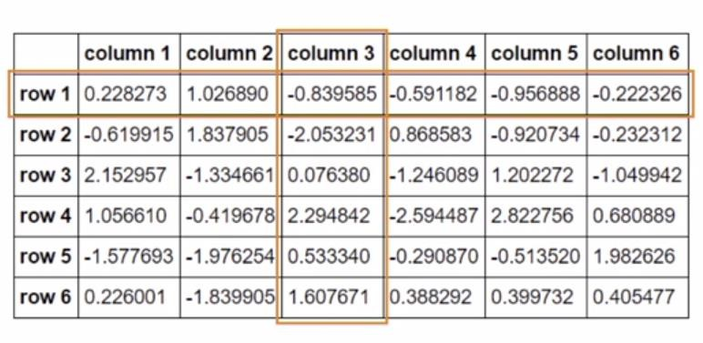
Introducing the pandas library
Series object:
A rows or column that is indexed
Dataframe can be made of more than one series or we can say that a Dataframe is a collection of series that can be used to analyse the data.
Copyright © 2018 Pearson Education, Inc. All Rights Reserved.

Slide 16
Data Preparation
1: Filtering and Selecting data
2: Treating missing values
3: Removing duplicates
4: Concatenating and transforming data
Copyright © 2018 Pearson Education, Inc. All Rights Reserved.

Slide 17
Missing Value
Missing values in python
Missing values are represented with Nan:
“Not a number”
Copyright © 2018 Pearson Education, Inc. All Rights Reserved.

Slide 18
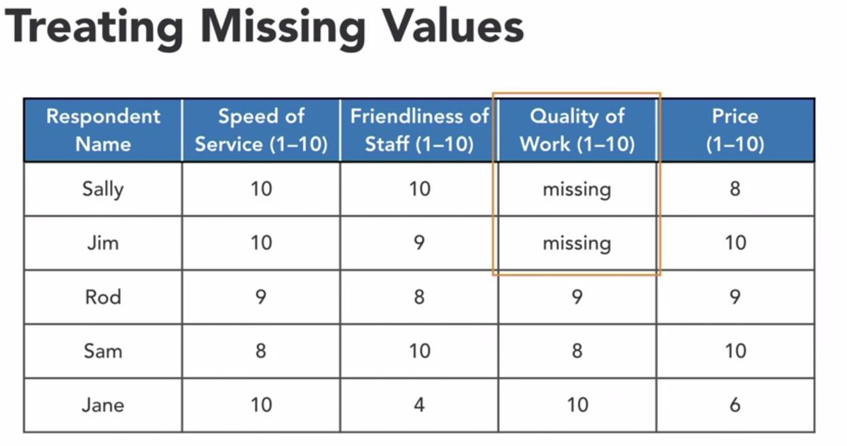
Copyright © 2018 Pearson Education, Inc. All Rights Reserved.

Slide 19
Remove Duplicates
Why remove duplicates
To maintain accurate, consistent datasets
To avoid producing wrong or misleading statistics
Copyright © 2018 Pearson Education, Inc. All Rights Reserved.

Slide 20
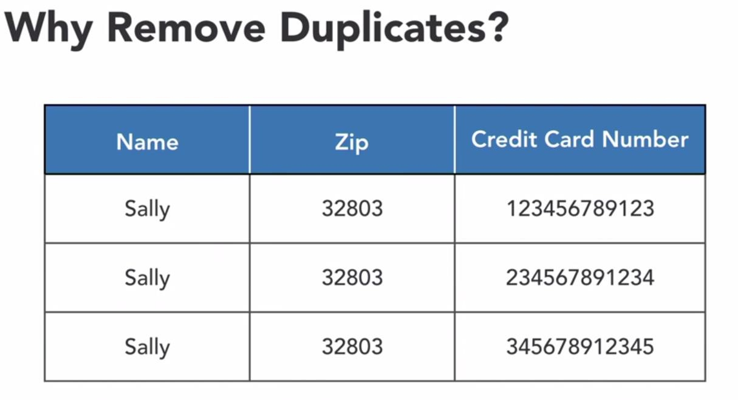
Copyright © 2018 Pearson Education, Inc. All Rights Reserved.

Slide 21
NumPy
NumPy (short for Numerical Python) provides an efficient interface to store and operate on dense data buffers.
Benefits:
Efficient storage
Data operations
Copyright © 2018 Pearson Education, Inc. All Rights Reserved.

